Slide 1
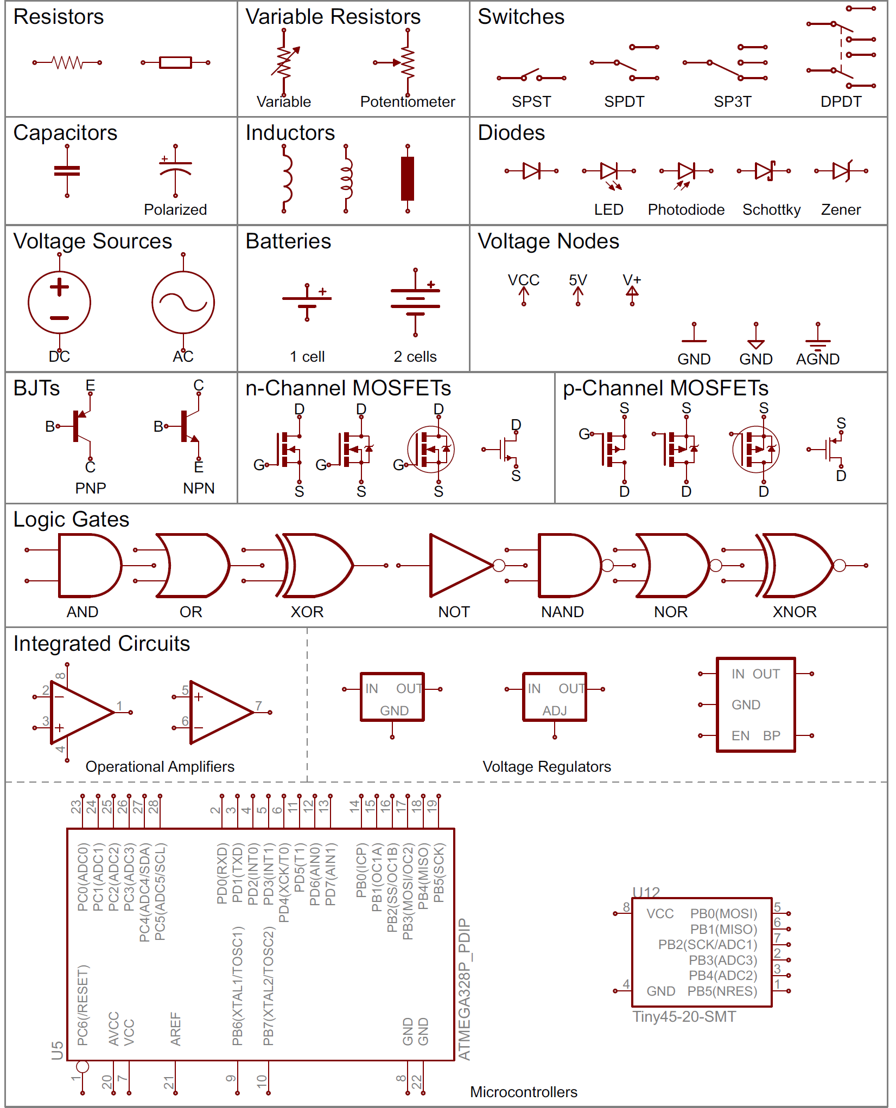

Introduction to Electronics and Schematics
GEARS Workshop
August 2021
Image: Sparkfun

Slide 2
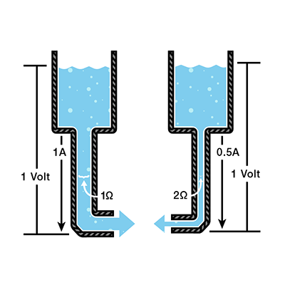

Electronics starts with an understanding of voltage, current, and resistance
Image: Sparkfun
Image: swtc.edu

Slide 3
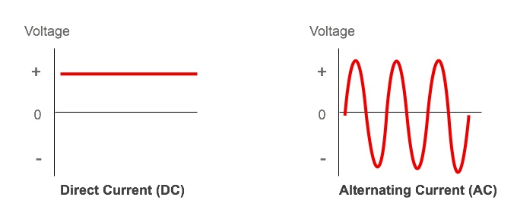
Electricity comes in “two” varieties
Image: Freeing Energy

Slide 4
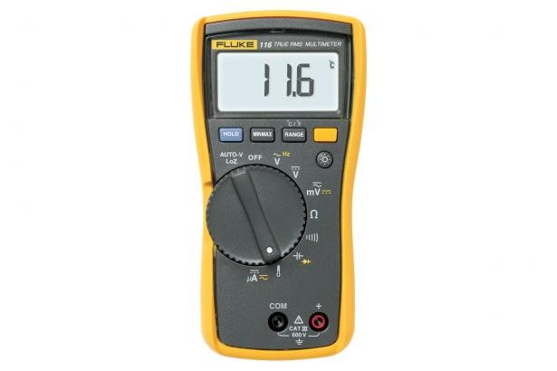
E, I, R can be measured with a multimeter
Image: Fluke Corporation

Slide 5
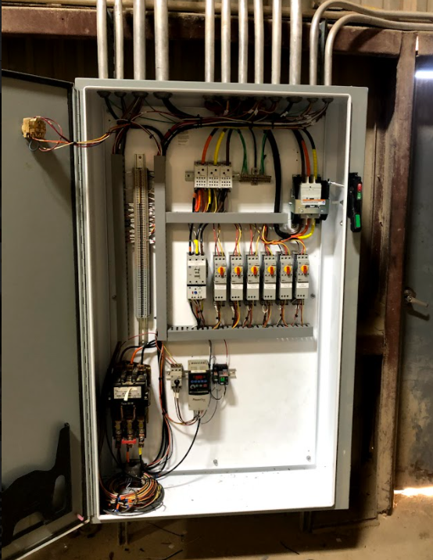
Wiring colors are NOT standardized in most cases
Red/Black/Green DC Power
White/Black/Green AC Power
Red/White/Blue or Orange/Yellow/Brown Three Phase
Blue/Brown are Control Power in Industrial Equipment
Or it’s whatever color the manufacturer decided (sometimes all one color)
Look for labels/numbers (and get a label maker)
Image: Leeman Geophysical

Slide 6
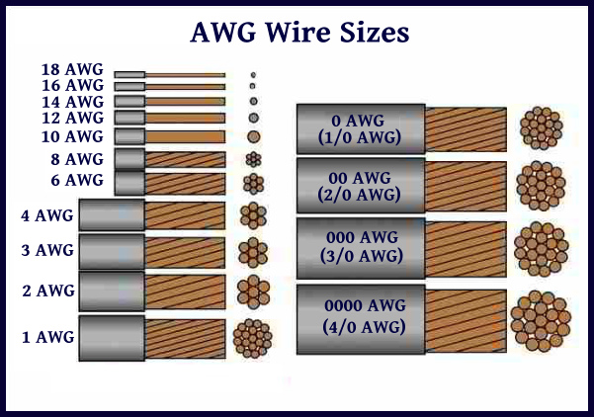
Wire is available in many sizes, styles, materials, and insulation materials
Current needed
Voltage limit
Type of power
Enclosed, free air, other
Multi-conductor
Shielded
Image: Just a Little Further

Slide 7
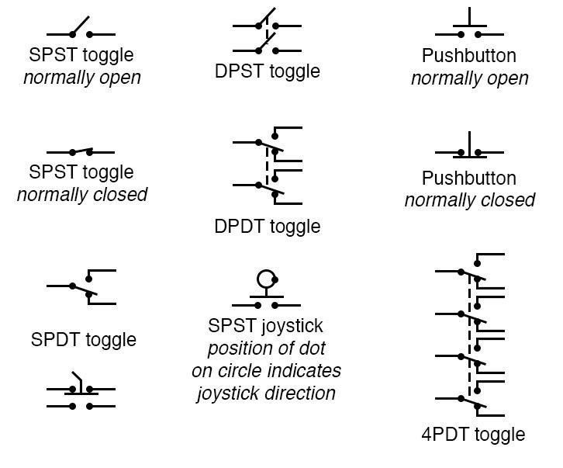
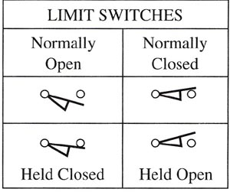
Switches are a common point of failure with complex nomenclature
Image: All About Circuits
Image: Industrial Electronics

Slide 8
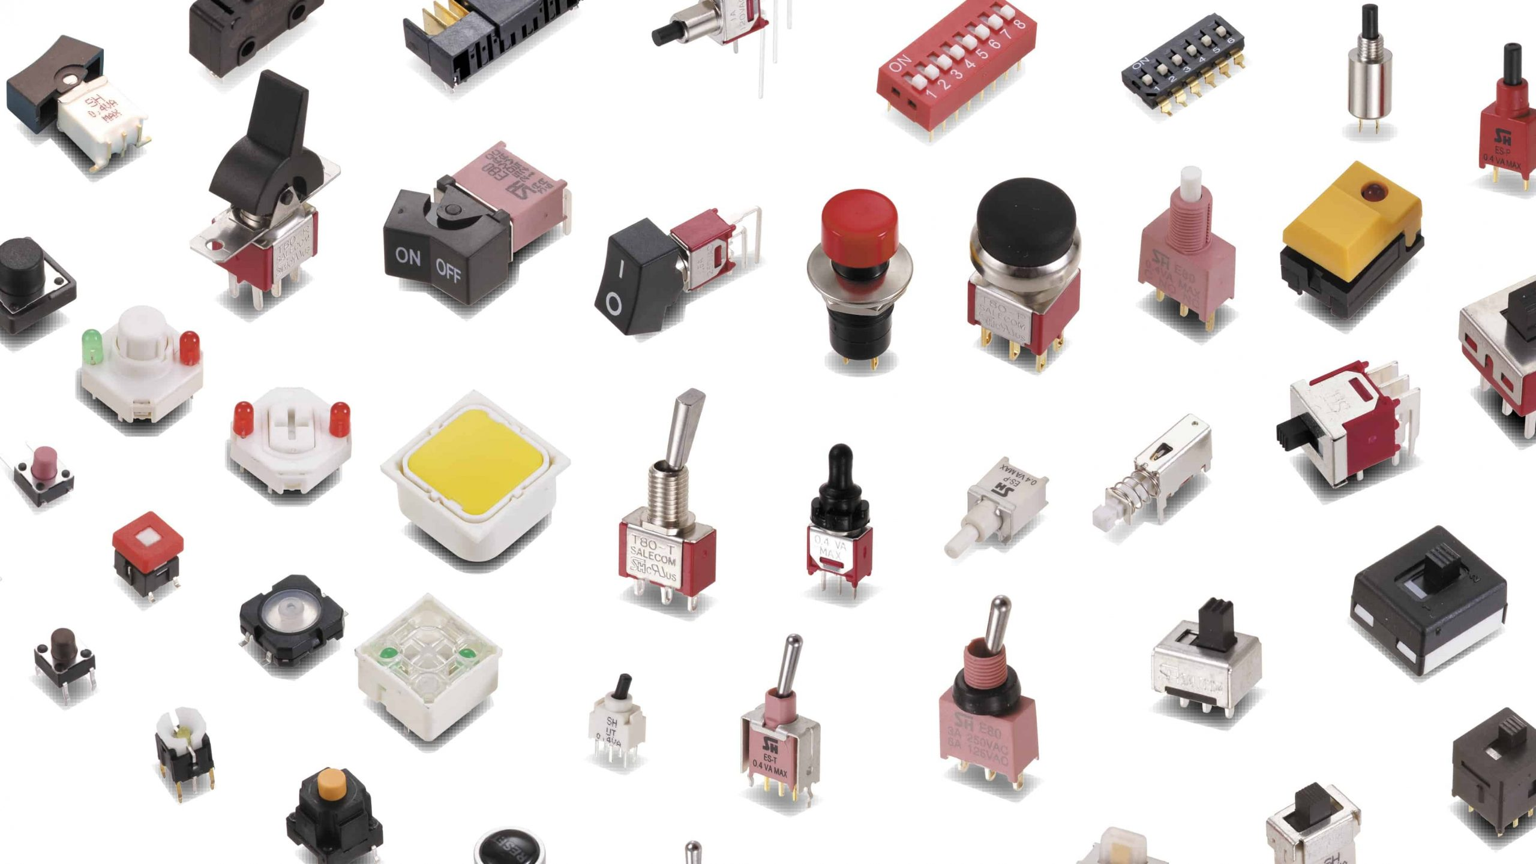
There are many many, switches available
Image: The Geek Pub

Slide 9
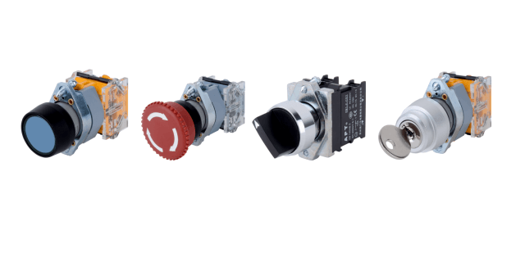
Let’s practice on some real switches – how do they hook up to a circuit?
Image: Quisure-Electrical Supply

Slide 10
Circuit protection is paramount – provide a fuse or one will be provided for you
Image: All About Circuits
Image: Industrial Electronics

Slide 11
Let’s look at a schematic
Image: All About Circuits
Image: Industrial Electronics

Slide 12
Let’s look at some basic theorems
Kirchhoff’s Laws
Thevenin’s Theorem
Norton’s Theorem
Image: Leeman Geophysical

Slide 13
Voltage Dividers
Kirchhoff’s Laws
Thevenin’s Theorem
Norton’s Theorem
Image: Leeman Geophysical

Slide 14
Wheatstone Bridges
Kirchhoff’s Laws
Thevenin’s Theorem
Norton’s Theorem
Image: Leeman Geophysical

Slide 15
Relays and contactors allow switching of larger loads than your circuit is capable of
Kirchhoff’s Laws
Thevenin’s Theorem
Norton’s Theorem
Image: Leeman Geophysical

Slide 16
Transistors and MOSFETS serve a similar purpose
Kirchhoff’s Laws
Thevenin’s Theorem
Norton’s Theorem
Image: Leeman Geophysical

Slide 17
Flyback diodes are commonly missed
Kirchhoff’s Laws
Thevenin’s Theorem
Norton’s Theorem
Image: Leeman Geophysical

Slide 18
Digital logic works as you’d expect Boolean expressions to work
Kirchhoff’s Laws
Thevenin’s Theorem
Norton’s Theorem
Image: Leeman Geophysical

Slide 19
Let’s look at some basic theorems
Kirchhoff’s Laws
Thevenin’s Theorem
Norton’s Theorem
Image: Leeman Geophysical

Slide 20
Let’s look at some basic theorems
Kirchhoff’s Laws
Thevenin’s Theorem
Norton’s Theorem
Image: Leeman Geophysical

